Slide 1
Mantid Scientific Steering Committee
Nick Draper
09/02/2010

Slide 2
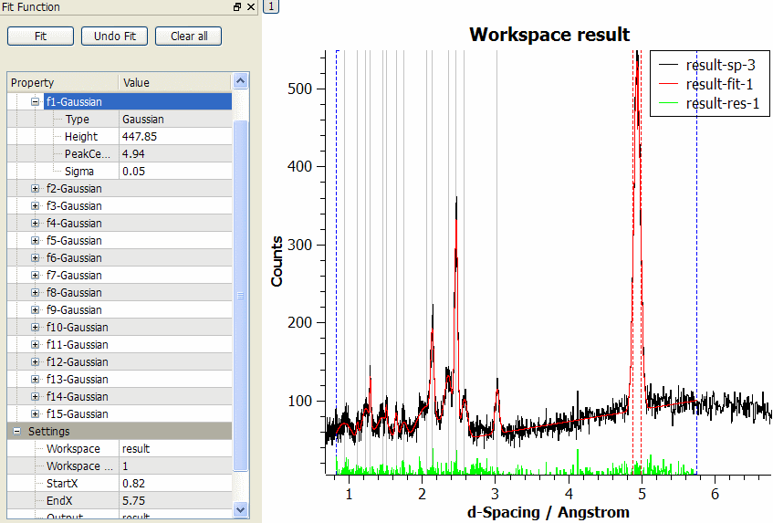
Progress over the last iteration
User interface changes
  Improved integration of Mantid and QtiPlot
  Improve usability for new users
Curve Fitting
  Simultaneous fitting of multiple peak and background functions
  Several Peak and Background functions
  Constrained and Tied Parameters
  Plot initial guess
  Choice of Minimiser function
  Fits with errors and covariance matrices

Slide 3
Progress over the last iteration
Python Algorithms
  Can manipulate data within workspaces
  Immediately available in the UI and in scripts
  No compilers required
  Plugin directory for automatic loading on startup
  Python algorithms can be submitted to mantid-help for inclusion into the framework and support
  Documentation http://www.mantidproject.org/Python_Algorithms
  Training will be arranged if there is enough interest

Slide 4
Progress over the last iteration
SANS
  Ability to limit by Phi range
  Beam centre finding improvements:
    Decreased memory usage
    Bug removed
  Load/Save CanSAS1D
Reflectometers
  WeightedMean algorithm to allow stitching of workspaces
Excitations
  Prototype Excitations ‘Homer’ user interface included

Slide 5
Progress over the last iteration
Muons
  Custom dialog added for PlotAssymetryByLogValue
  MuonNexus version 2 files now supported
Crystallography
  Flat plate and HPRDSlabCanAbsorption added
Molecular Spectroscopy
  SaveDasc
  Load / SaveSPE

Slide 6
Progress over the last iteration
Outreach
  SNS visits and agreement impending
  ILL visit
  ESS industry day

